Slide 1
Octoraro Rail Trail

Slide 2
Intro
DCTMA formed Bike/Ped Committee in 2012
Mission is to support implementation of Delco Bike Plan
Selected Octoraro Rail-Trail as top priority
“Octoraro is the best remaining rail-trail opportunity in Delaware County after the Chester Creek Trail”
-- Delaware County Bike Plan

Slide 3
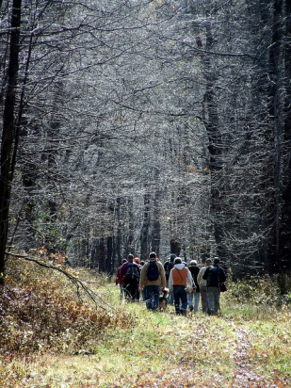
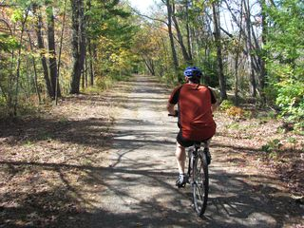
Vision
A shared greenway through the heart of Delaware County that:
Provides alternative, multi-modal access to jobs
Builds a sense of community
Preserves open space and helps the environment
Provides multi-use and non-motorized transportation opportunities
Biking
Hiking
Running
XC skiing
Encourages physical fitness and healthy lifestyles
Preserves and links cultural & historic attractions

Slide 4
History
Construction began in 1854
Began operations in 1859
110 miles of track going from West Philadelphia to Octoraro Junction, MD
Operated by a variety of railroads until 1990’s
Baltimore and Philadelphia Railroad/Octoraro Branch
Pennsylvania Railroad
Wawa and Concordville Railroad
Octoraro Railroad
Septa eventually purchased the Right of Way for the section of line in Delaware County
Trail could include signs to interpret history of the railroad and the region

Slide 5
History

Slide 6
Route
Much of it follows West Branch of Chester Creek & its tributaries
Connections include:
Newlin Grist Mill
Ivy Mills
New Wawa train station (with parking for 600)
Chester Creek Trail and the Middletown township trail system
Concordville Town Centre
Applied Card Systems
Shopping at proposed businesses along 202
Spring Valley Business Park
Chadds Ford Business Campus
Proposed Main Line Health hospital
Wawa Headquarters and Dairy

Slide 7
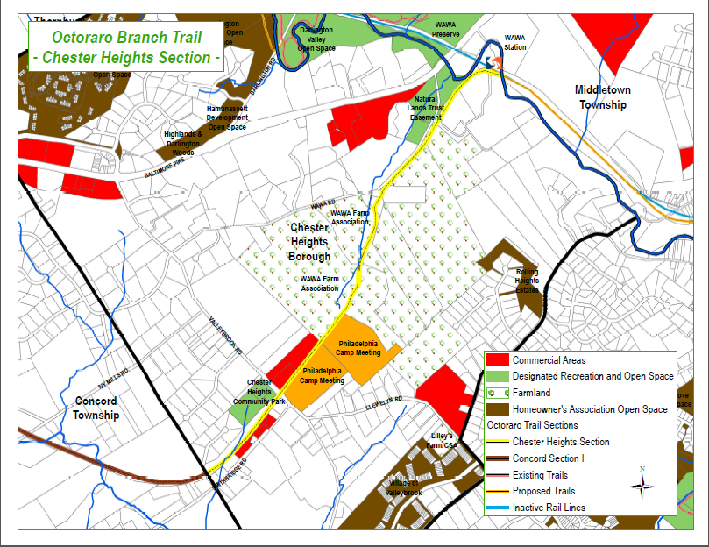
Chester Heights Section of Trail

Slide 8
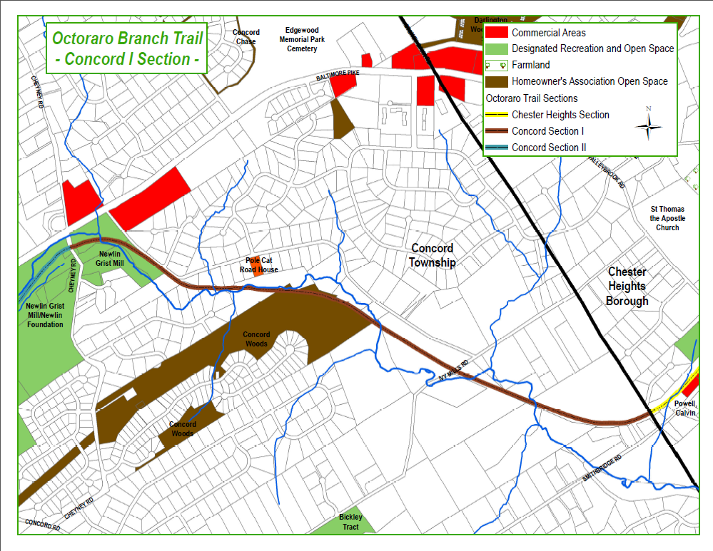
Concord Section of Trail

Slide 9
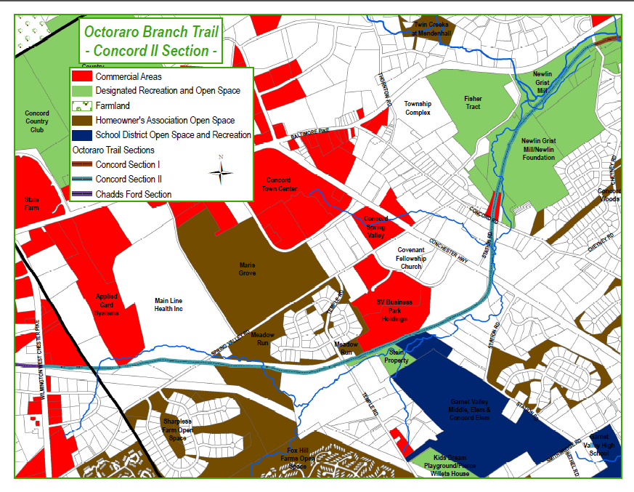
Concord II Section of Trail

Slide 10
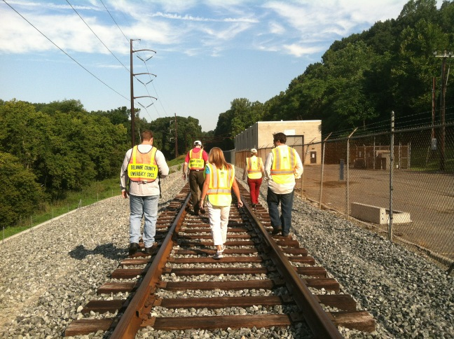
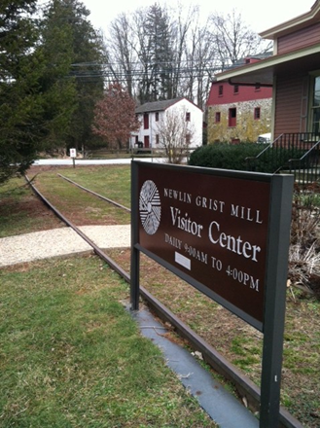
Condition of Trail
Trail is in good condition and poses relatively few obstacles to conversion
Tracks in place (though overgrown) for much of the right-of-way
Nine existing at grade crossings and two missing bridges with potential for at grade crossings
Several minor wash-outs
Most of trail runs through undeveloped land on high embankments or in cuts

Slide 11
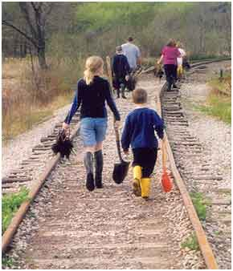
Trail Maintenance
Trail maintenance includes:
Clearing debris
Litter removal
Periodic surface treatment

Slide 12
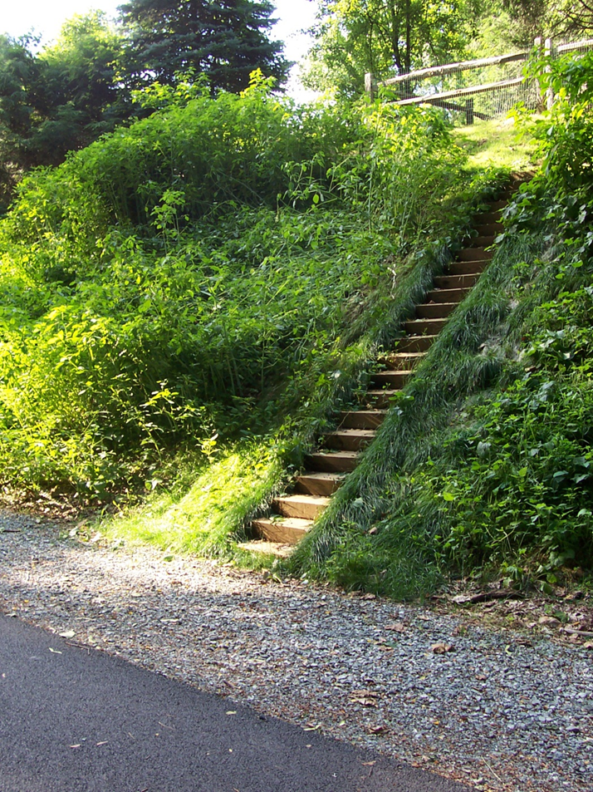
Safety
Crime
Undeveloped Right of Ways have more crime than trails
When people are around there is less illicit activity
Making the Octoraro into a rail-trail is the best way to prevent problems
Notes:
Misperceptions re Crime
Undeveloped RoWs often crime havens because they are accessible yet unused, unmaintained and unpatrolled
When trail is installed and public use increases, illicit activity is reduced as drug users, aloholics, and underage drinkers seek less public places
Homes on roads are more attractive to criminals than homes on rail-trails since they desire access to cars for quick get away

Slide 13
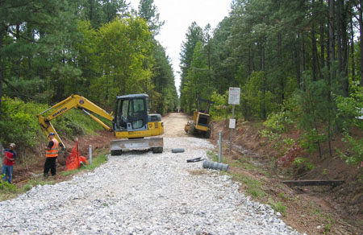
Development Plan
Feasibility Study
Right of Way
Benefits and Costs
Surface Type
Historic Inventory
Utility Considerations
Funding Identification
Approvals & Permits
Design
Construction

Slide 14
Community Support
Octoraro Trail is in the Delaware County Bike Plan & Township Master Plans
But it won’t happen without your support
We would appreciate your support for our feasibility study funding application

Slide 15
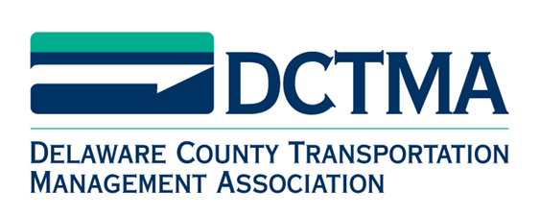
Contact Us
The Delaware County Transportation Management Association
www.dctma.org
Phone - (610) 892 – 9440
Email – info@dctma.org
DCTMA Bicycle Committee
Chuck Cruit: 610-348-6185
Eric Ostimchuk: 610-326-3100

