Slide 1
Helping your employees navigate their commute during I-95 construction

Slide 2
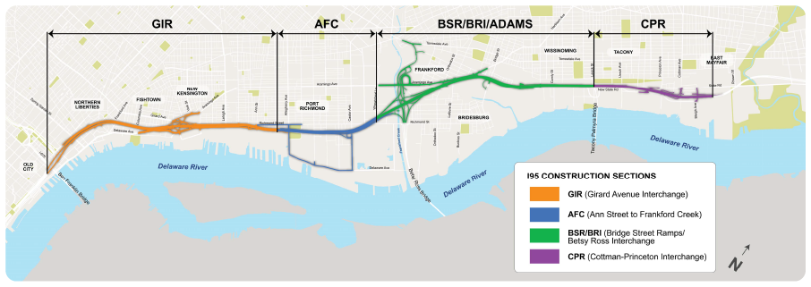
I-95 CONSTRUCTION 101
Five sections between I-676 and Cottman Avenue
At least three lanes open at all times in construction zones
Full completion expected in 2030 (everything)
Final: 4 lanes each direction; improved on/off ramps, new bridges
Construction info and more: www.95revive.com

Slide 3
QUESTIONS FOR EMPLOYERS
Do you know how your employees get to work?
If they drive, do they use I-95?
If they use I-95, what part?
Could they use transit as an alternative?
Why is their commute important to your company?

Slide 4
WHY EMPLOYERS SHOULD CARE
Employees stuck in traffic get to work already stressed
Employees who face difficult commutes are more prone to take sick days
Stressed and absent employees can mean lower productivity
Employees caught in traffic contribute to air pollution

Slide 5
DO YOU KNOW HOW YOUR EMPLOYEES GET TO WORK?
Where do they travel from?
At what times?
Survey
Transportation Fair
How many use I-95 regularly?
Where they live and what time they commute make a difference

Slide 6
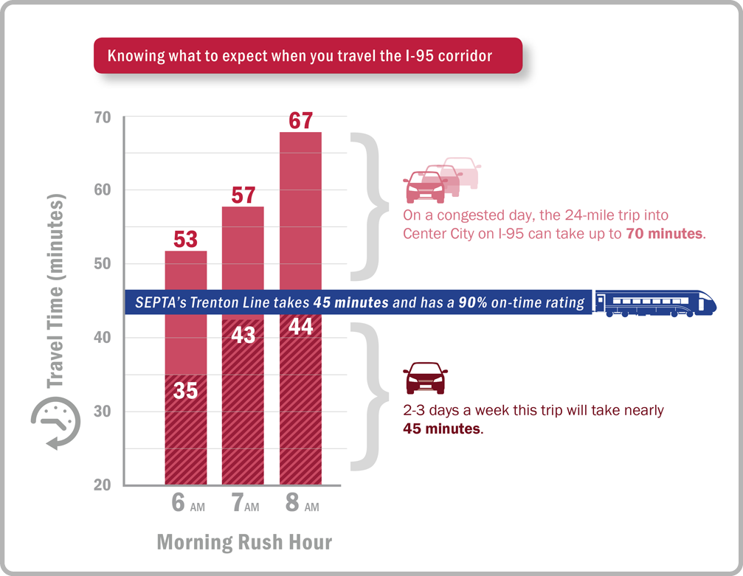
THE MORNING COMMUTE FROM BUCKS COUNTY INTO CENTER CITY
(Commute time graphic)

Slide 8
FLEX TIME
Allows employees to alter their commute times slightly to accommodate more efficient travel schedules – either driving (alone or in carpools) or taking transit
Company-wide or on an individual basis

Slide 9
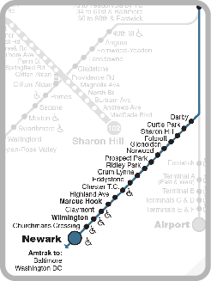
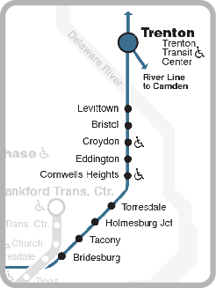
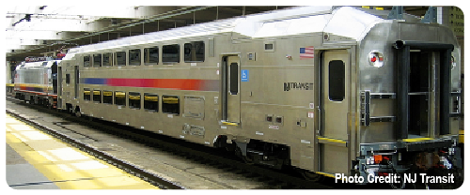
USING TRANSIT
Two lines that basically parallel I-95:
Wilmington/Newark (south of Philadelphia)
Trenton (north of Philadelphia)
Increase service and add bi-level cars
Promote specific available/added parking

Slide 10
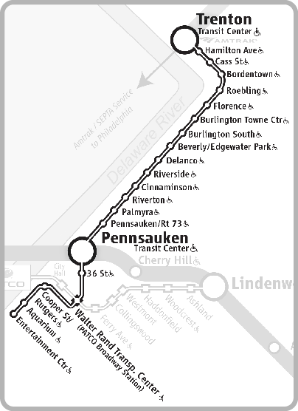
USING TRANSIT CONTINUED
NJ Transit’s RiverLine serves many New Jersey suburbs that feed onto I-95
Bus routes cover even more – SEPTA and NJTransit
Connect with NJ Transit trains and buses, too

Slide 11
CAR AND VAN POOLS
Two or more commuters share a vehicle to work
Third-party company provides van for larger groups (6+)
Agree on where to meet/pick up, who drives, compensation

Slide 12
RIDE MATCHING
Online service to match commuters
Share-A-Ride: free service providing matches to:
Transit options
Carpool/vanpool contacts
Bicycling and walking route groups
For employers (matching at work site) or individual commuters
Not one-time or infrequent trips

Slide 13
TELEWORK
Work from home or at a remote location
No commuting required!
Can be casual or a formal policy
Can be short term or a regular option

Slide 14
COMPRESSED WORK WEEK
Work same weekly hours in fewer days
Four 10-hour days with one day off each week
Nine 9-hour days with 10th day off
Keeps employees off the road one day (or more)

Slide 15
INCENTIVES AND REWARDS
Encourages change
Transit benefit (RideECO) – saves money for both employees and employers
Enter contest/raffle or earn “points” for prizes
On-site amenities

Slide 16
SUPPLEMENTAL PROGRAMS
Emergency Ride Home (ERH)
Parking Management/Preferred Parking
Park and Ride network
Air Quality Partnership (AQP)
Other

Slide 18
CONTACT INFORMATION
Delaware County TMA
610-892-9440| www.dctma.org
www.dvrpc.org/commute95
DVRPC Contacts:
Commuter Services Stacy Bartels: sbartels@dvrpc.org
Communications and Outreach Elise Turner: eturner@dvrpc.org
Construction Assistance Information Jesse Buerk: jbuerk@dvrpc.org

